Slide 1
Epileptic Seizure Detection by DWT
Abdul Haseeb Ayub
Ahmad Tariq
Reida Iqbal

Slide 2

THE PROBLEM: Epilepsy
Neurological Disorder
Seizure Attacks

Slide 3
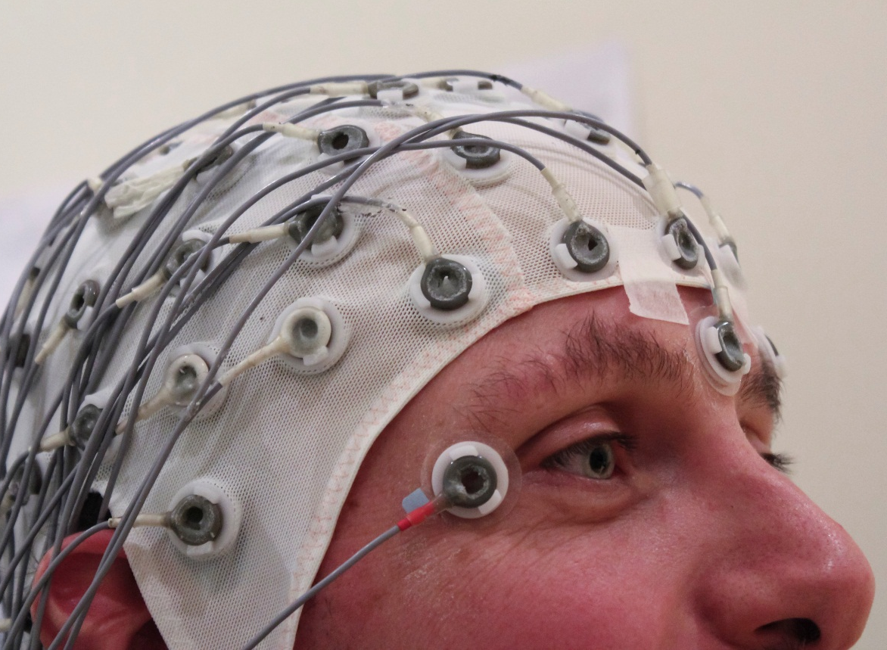
OBJECTIVE: Seizure Detection
Detect seizure in EEG signals
Present related part for analysis

Slide 4
FLOWCHART
EEG Signal
Wavelet Decomposition
δ , θ
Frequency Extraction
Classification
Feature Extraction
Framing

Slide 5
ALGORITHM
Read EEG signal
Framing (5000 samples/frame)
Decompose the signal using Wavelet Transform (5 Level)
δ Rhythm (f<4 Hz) , θ Band (4-8 Hz) Extraction
Features (Mean & Standard Deviation) Extraction
Thresholding & Classification

Slide 6
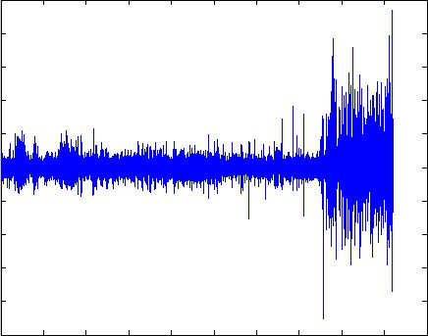
RESULTS

Slide 7
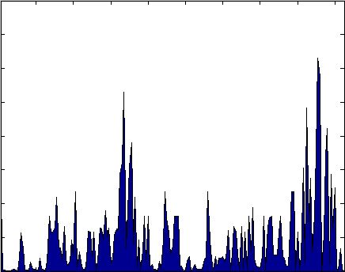
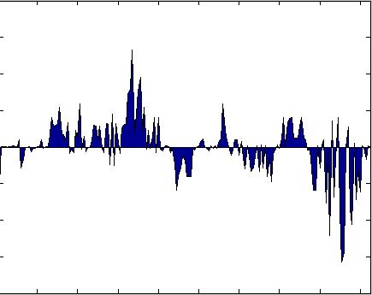
RESULTS
FEATURE 1
FEATURE 2

Slide 8
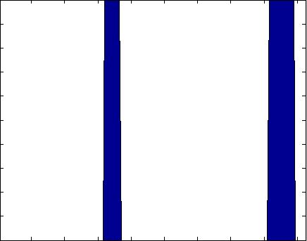
RESULTS

Slide 9
CONCLUSION
PROS
CONS
Able to detect multiple seizures
For Analysis & Study
Difficult real-time implementation
Inaccurate

